Slide 1
AI FAQ Assistant API
TEAM LEADER : T LAVANYA
TEAM MEMBER : 1.P MUGILARASI
TEAM MEMBER : 2.S NIVEDHAPRIYA
TEAM MEMBER : 3.P POOMATHI
TEAM MEMBER : 4.P PRABAVATHI
PROJECT TITLE:
AI FAQ ASSITANT:FASTER,SMARTER,CUSTOMER SUPPORT
Description:
The AI FAQ Assistant: Faster, Smarter Customer Support is an intelligent customer-support system that uses Artificial Intelligence and Natural Language Processing (NLP) to understand customer questions and provide quick, accurate, and relevant answers. It automates responses to frequently asked questions, reducing the workload of support staff and improving response time. The system can be trained using FAQs, product details, policies, and other support information, enabling customers to receive instant assistance 24/7. This project aims to make customer service faster, more efficient, accessible, and user-friendly while allowing human agents to focus on complex customer issues.

Slide 2
SCENARIO BASED CASE STUDY:
Background:
A large e-commerce company receives a high volume of customer queries every day regarding orders, delivery, returns, refunds, payments, and product information. Most of these questions are repetitive and require customer-support employees to provide the same information repeatedly.
Problem:
Customers often have to wait for support because of the large number of queries. Support employees spend valuable time handling simple and frequently asked questions, which reduces their ability to focus on complex customer issues. The company needs a faster and more efficient way to handle routine queries.
Solution:
The company introduces an AI FAQ Assistant that uses Artificial Intelligence and Natural Language Processing (NLP) to understand customer questions and provide relevant answers automatically. The assistant uses a knowledge base containing FAQs, product information, company policies, and support instructions. If the AI cannot resolve a complex query, it transfers the customer to a human support agent.

Slide 3
Usage:
Customers can interact with the AI Assistant through the company's website or application. For example, a customer may ask, “How can I return my order?” The assistant identifies the question and provides the return procedure immediately. It can also answer questions about order tracking, delivery time, refunds, cancellations, payment methods, and product information.
Outcome:
The AI FAQ Assistant provides 24/7 customer support, reduces response time, and decreases the workload of customer-support employees. Customers receive quick answers to common questions, while human agents can focus on more complicated problems. Overall, the system improves support efficiency and creates a faster and more convenient customer experience.

Slide 4
Software Requirements
Operating System: Windows 10/11, Linux, or macOS
Programming Language: Python
Frontend: HTML, CSS, JavaScript / React
Backend: Python Flask or Django
Database: MySQL / MongoDB
Hardware Requirements
Processor: Intel Core i3 or equivalent and above
RAM: Minimum 4 GB, recommended 8 GB
Storage: Minimum 10 GB of free space
Display: 1366 × 768 resolution or higher
Keyboard and Mouse
Internet Connectivity: Wi-Fi or Ethernet

Slide 5
Epic 1: PROJECT ARCHITECTURE
USER
↓
Chat Interface
↓
Backend Server
↓
Query Processing
↓
NLP / AI Engine
↓
FAQ Knowledge Base
↓
Answer Generation
↓
Response to User
↓
Human Support Agent
(if required)

Slide 6
Main Components
User Interface: Allows customers to enter questions and view responses.
Backend Server: Receives user queries and manages communication between the system components.
NLP/AI Engine: Understands the user's question and identifies its intent.
FAQ Knowledge Base: Stores frequently asked questions, answers, product details, policies, and support information.
Response Generation: Selects or generates the most relevant answer based on the user's query.
Human Support Module: Transfers unanswered or complex queries to a customer-support representative.
Database: Stores FAQ data, conversation information, and system-related records.

Slide 7
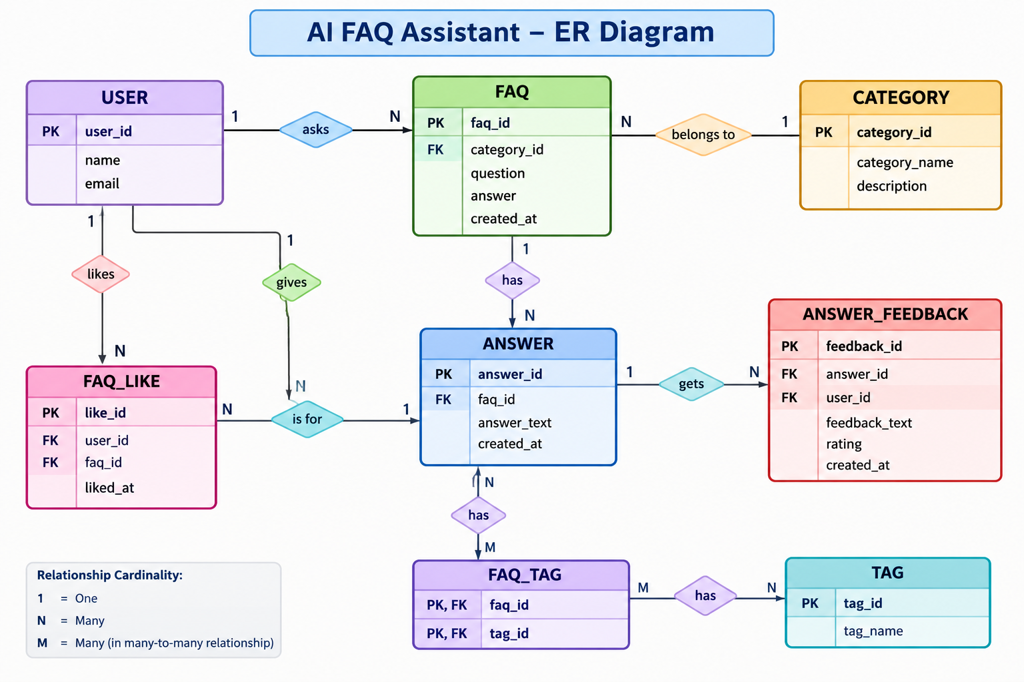

Slide 8
Key Structural Mappings
For the AI FAQ Assistant, the key structural mappings are:
Entity | Key atrributes | Relatoinship
User | User_id(PK),name,email | User submit Queries
Query | Query_id(PK),user_id(FK),question | Query belongs to a User
FAQ | Faq_id(PK),question,answer | Query is matched with FAQ
Response | Response_id(PK),query_id(FK),answer | Response is generated for Query
Support Agent | Agent_id(PK),name | Agent handles unresolved Queries

Slide 9
Key Features:
AI-Powered Responses – Automatically understands customer questions and provides relevant answers.
24/7 Availability – Provides customer support at any time.
Natural Language Processing – Understands questions written in normal human language.
Instant FAQ Search – Quickly searches the FAQ knowledge base for suitable answers.
User-Friendly Chat Interface – Allows customers to interact easily through a simple chat system.
Human Agent Support – Transfers complex or unanswered queries to a support agent.
Roles and Responsibilities
1. Admin
Manage and update the FAQ knowledge base.
Add, edit, and delete FAQ questions and answers.
Monitor system performance and user queries.
Manage support-agent information.
2. User / Customer
Enter questions through the AI chat interface.
View AI-generated answers.
Submit follow-up questions.
Contact a support agent when required.

Slide 10
3. AI Assistant
Understand user queries using NLP.
Identify the user's intent.
Search the FAQ knowledge base.
Generate relevant responses.
Identify unanswered or complex queries.
Forward complex queries to a human support agent
4. Support Agent
Handle queries that cannot be resolved by the AI.
Provide personalized solutions to customers.
Review unresolved queries.
Update the FAQ knowledge base with useful new information.
Flow Steps
Start – User opens the AI FAQ Assistant.
Enter Query – User types a question.
Query Processing – AI analyzes and understands the question.
FAQ Search – System searches the FAQ knowledge base.
Answer Available – If a suitable answer is found, it is displayed to the user.
No Answer – If no suitable answer is found, the query is forwarded to a support agent.
Solution – User receives the required information or solution.
End – User can close the chat or ask another question.

Slide 11
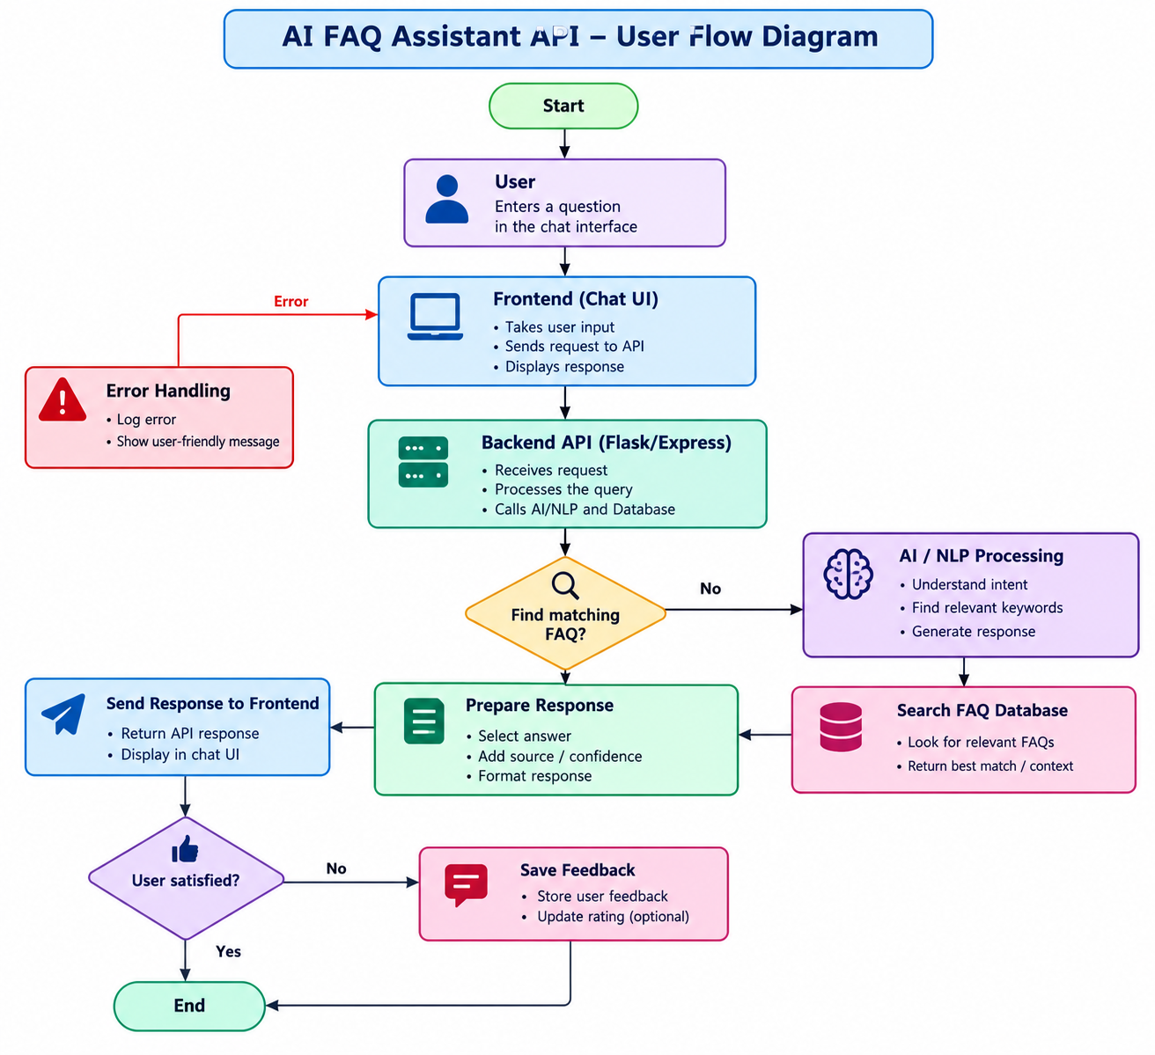

Slide 12
MVP Architecture
👤 User
Ask FAQ / Customer Question
💬 Frontend
Chat Interface
⚙️ Backend REST API
Request Handling • Authentication • Business Logic
🗄️ FAQ Database
Questions • Answers • Categories
🤖 AI / NLP
Understand User Query
🔎 Semantic Search
Find Relevant FAQ
✨ AI Response Generator
Generate Accurate & User-Friendly Answer
✅ Final Answer
Response displayed to the user

Slide 13
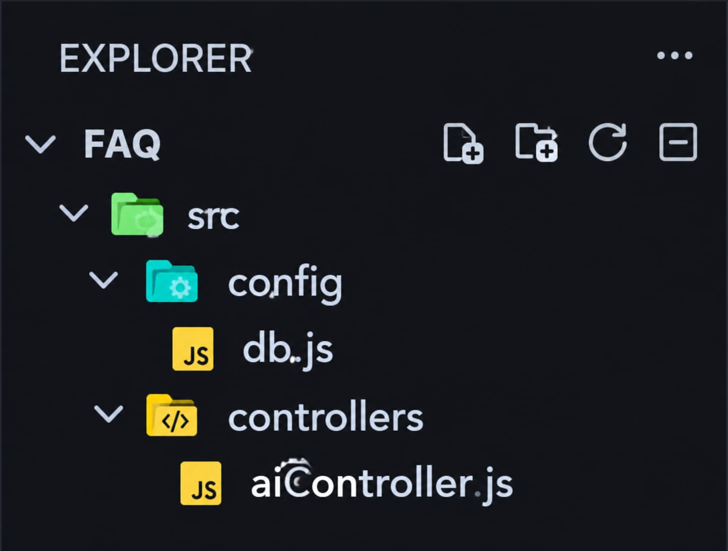
EPIC 2: Project Setup and Configuration
2.1 Create Project Folder
Create the main project folder named AI FAQ Assistant API.
Create separate folders for Frontend, Backend, Database, and Documentation.
Organize all project files and resources in their respective folders.
2.2 Server Setup – npm init
Open the AI FAQ Assistant API project folder in the terminal.
Run npm init -y to initialize the Node.js server project.
This creates the package.json file for managing server dependencies and configuration.

Slide 14
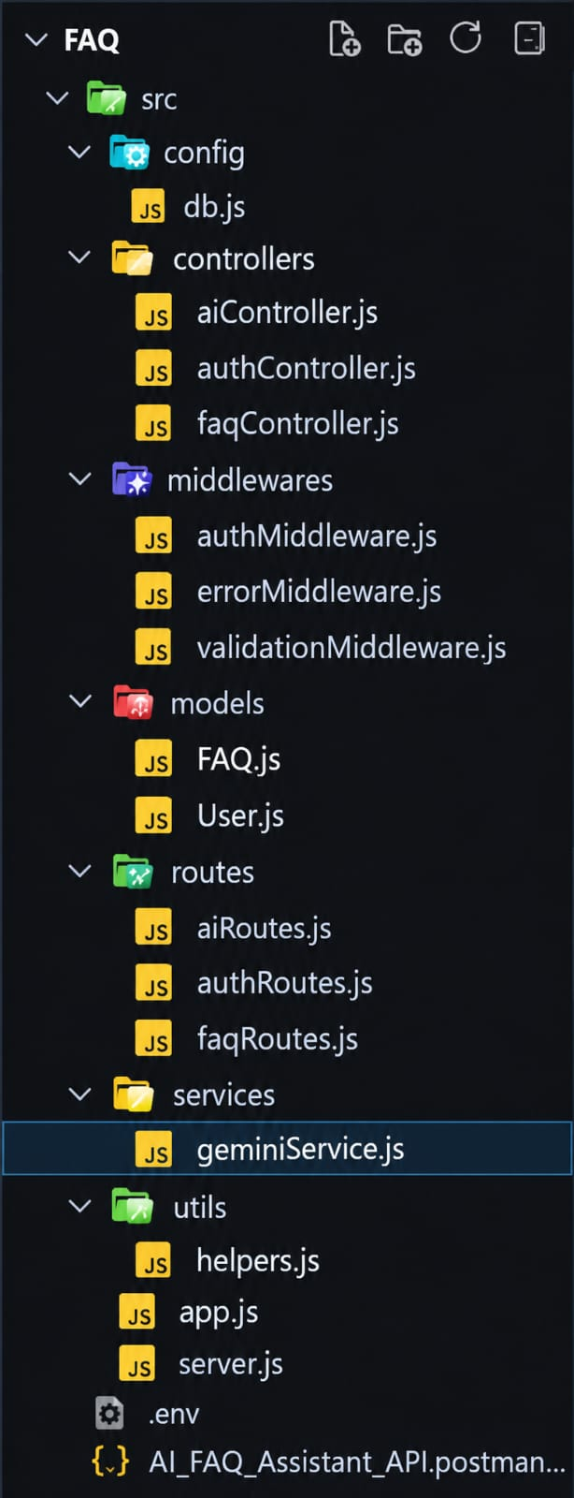
Core system script implementations

Slide 15
EPIC 3: Backend Development
3.1 Server Configuration
Create and configure the backend server.
Install required Node.js packages.
Connect the server with the database.
3.2 API Development
Create REST API endpoints.
Implement FAQ CRUD operations.
Handle user requests and API responses.
3.3 AI FAQ Integration
Process the user's question.
Search for the relevant FAQ.
Generate and return the appropriate answer.
3.4 Feedback & Like Management
Implement FAQ like functionality.
Store answer feedback.
Retrieve feedback and rating data.

Slide 16
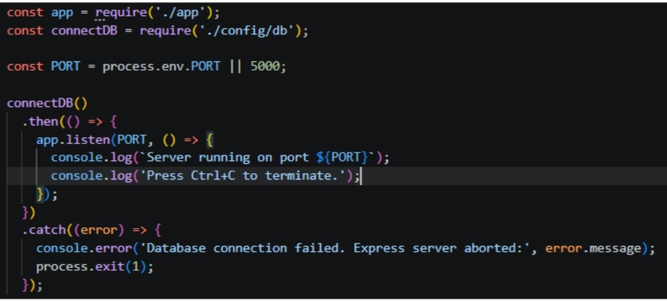
1.Application Entry Point(index.js)
The index .js file serves as the main entry point of the application.It initializes the Express server,loads environment variables configures middleware,establishes the MongoDB connection ,register API routes and starts the server after a successfully
Database connection

Slide 17
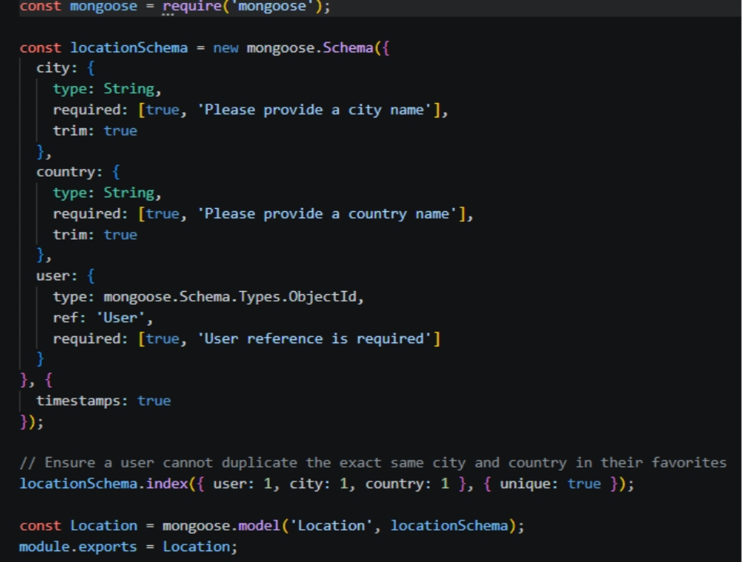
Epic4:Database Configuration
Database Configuration
Create the AI FAQ Assistant database.
Configure database connection with the API.
Store database credentials securely using ".env".
Create tables for User, FAQ, Category, FAQ Like, Answer Feedback, Tag and FAQ Tag.
Establish relationships between the tables.
Test the database connection with the backend API.

Slide 18
Epic5:Project Execution
- Set up the project environment and folder structure.
- Configure the Node.js server and database.
- Develop REST API endpoints for FAQ management.
- Implement user, category, tag, like and feedback modules.
- Connect the API with the database.
- Test API requests and responses using Postman.
- Run the complete AI FAQ Assistant system successfully.
Running the Backend Server
install all required dependencies:
npm install
Start the development server:
npm start

Slide 19
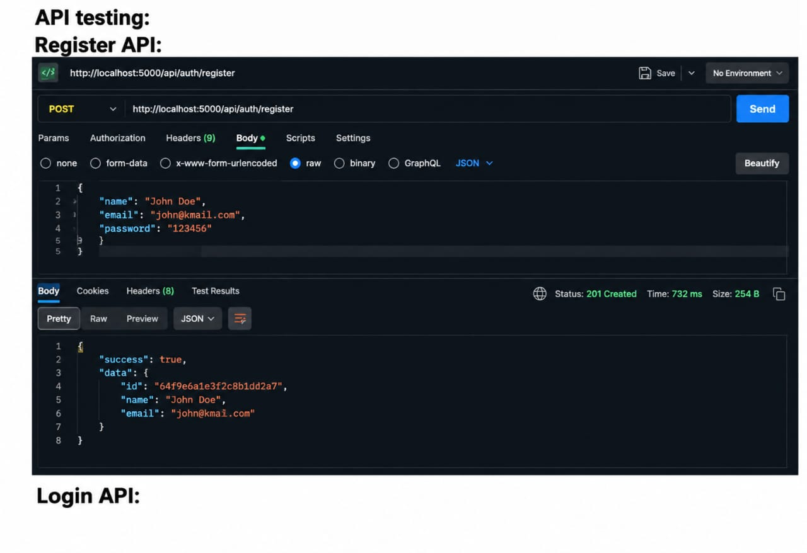

Slide 20
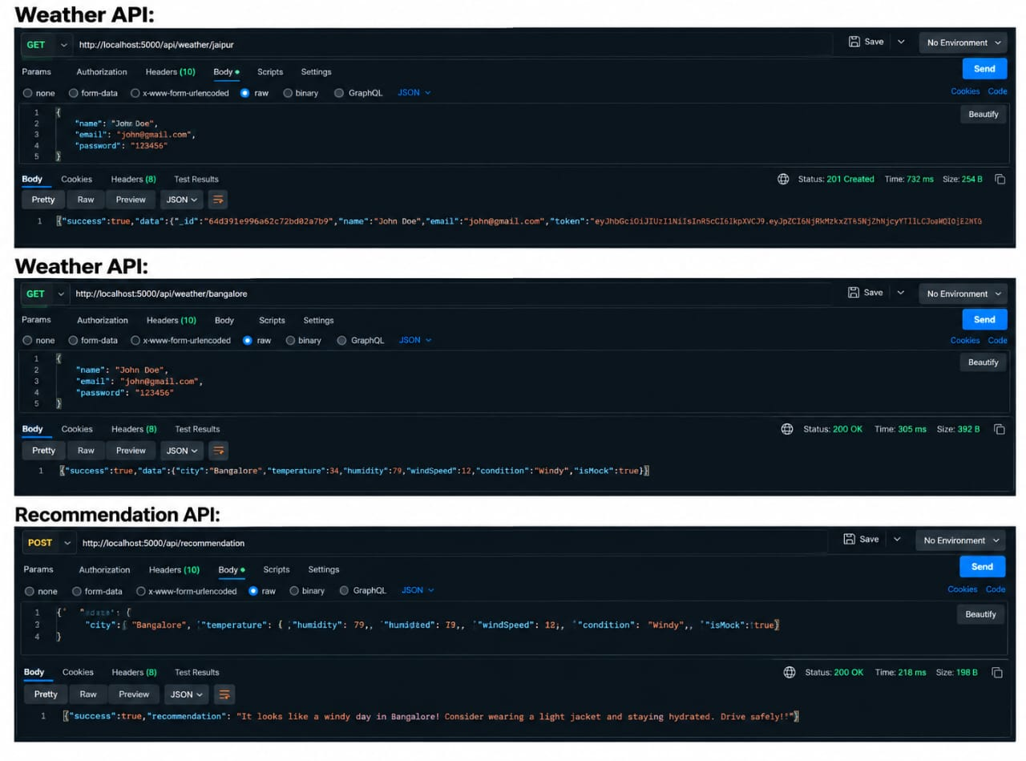

Slide 21
API TESTING VIDEO LINK:API testing.mp4
DEMO video link:Backend demo.mp4
codeDrive:code

